Slide 1
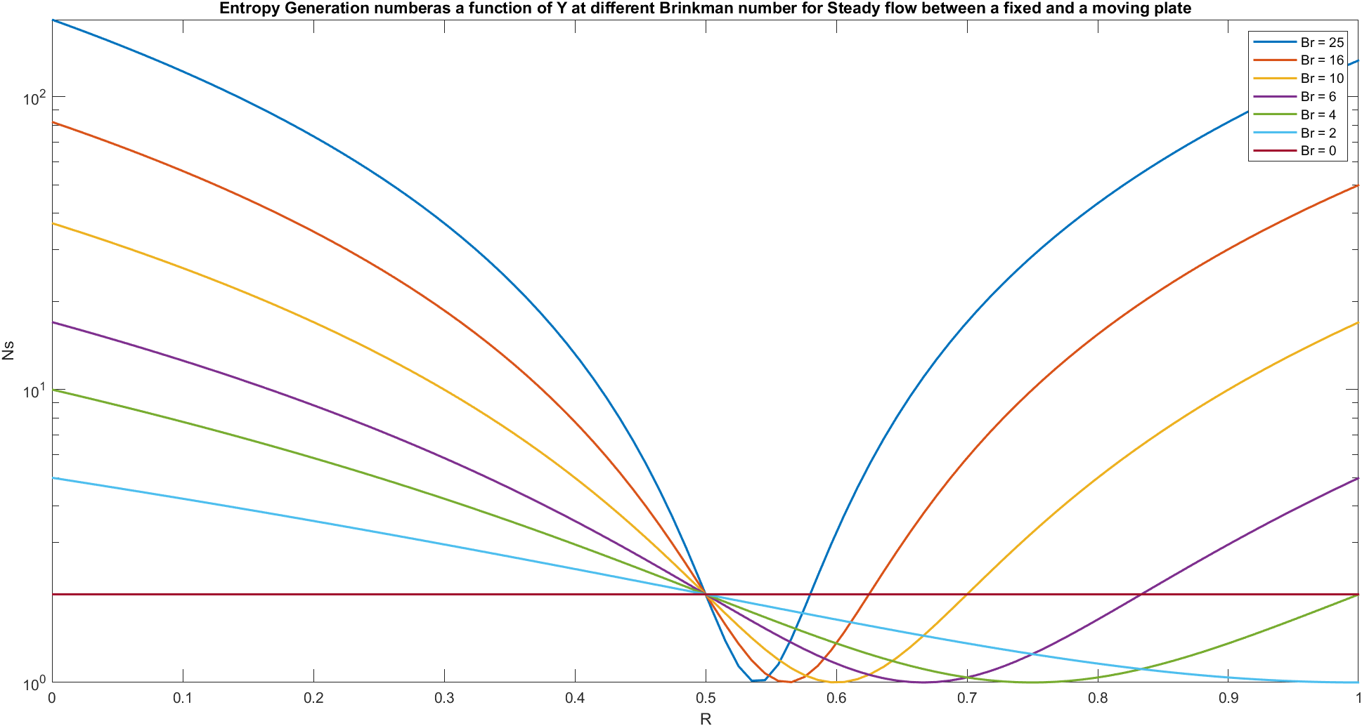
Assignment
Heat and Mass Transfer (MEC 403 )
Prof. Achintya Kumar Pramanick
Name : Prince Maurya Roll no. 21ME8011 Date :21st March 2023
3.1
Steady flow between a fixed and a moving plate
Code :
Y = linspace(0,1,100);
semilogy(Y,(1+(25./2)-25*Y).^2 +1,LineWidth=1.5)
xlabel('R')
ylabel('Ns')
title('Entropy Generation numberas a function of Y at different Brinkman number for Steady flow between a fixed and a moving plate')
hold on
plot(Y,(1+(16./2)-16*Y).^2 +1,LineWidth=1.5)
plot(Y,(1+(10./2)-10*Y).^2 +1,LineWidth=1.5)
plot(Y,(1+(6./2)-6*Y).^2 +1,LineWidth=1.5)
plot(Y,(1+(4./2)-4*Y).^2 +1,LineWidth=1.5)
plot(Y,(1+(2./2)-2*Y).^2 +1,LineWidth=1.5)
plot(Y,(1+(0./2)-0*Y).^2 +1,LineWidth=1.5)
hold off
legend("Br = 25","Br = 16","Br = 10","Br = 6","Br = 4","Br = 2","Br = 0")
Graph:

Slide 2
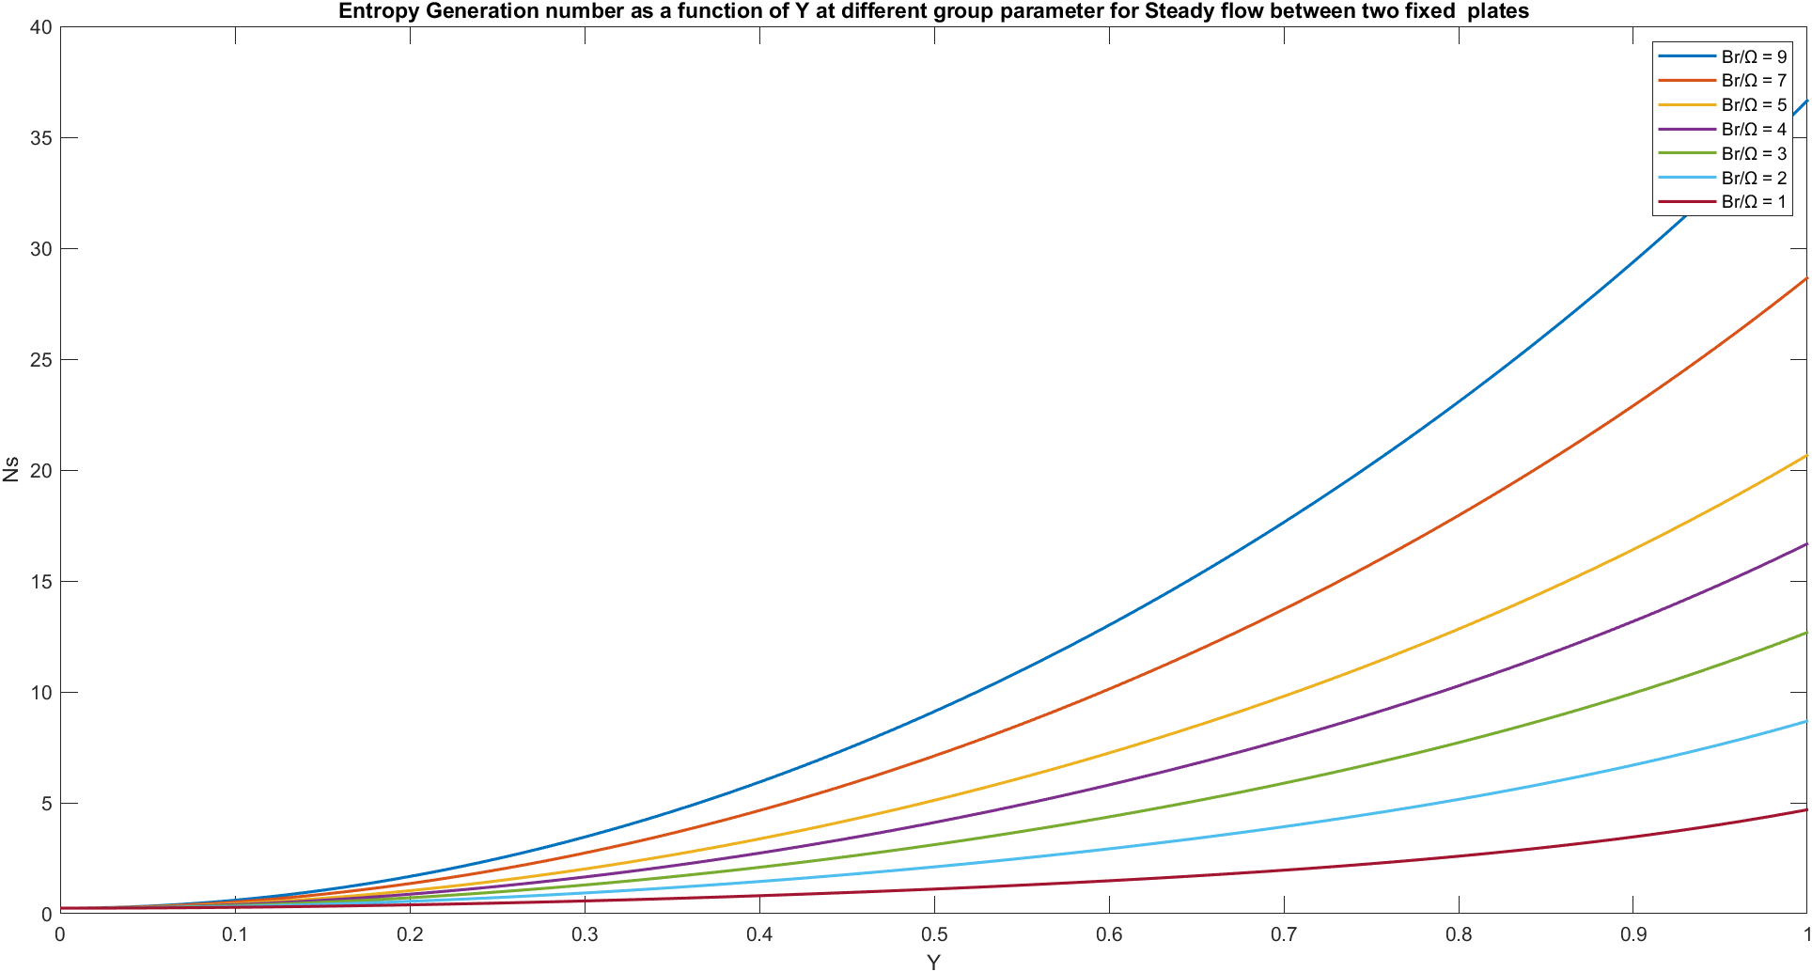
3.2
Steady flow between two fixed plates
Code :
Y = linspace(0,1,100);
plot(Y,(0.5-1.3333*Y.^3).^2+4*Y.^2*9,LineWidth=1.5);
xlabel('Y')
ylabel('Ns')
title('Entropy Generation number as a function of Y at different group parameter for Steady flow between two fixed plates')
hold on
plot(Y,(0.5-1.3333*Y.^3).^2+4*Y.^2*7,LineWidth=1.5);
plot(Y,(0.5-1.3333*Y.^3).^2+4*Y.^2*5,LineWidth=1.5);
plot(Y,(0.5-1.3333*Y.^3).^2+4*Y.^2*4,LineWidth=1.5);
plot(Y,(0.5-1.3333*Y.^3).^2+4*Y.^2*3,LineWidth=1.5);
plot(Y,(0.5-1.3333*Y.^3).^2+4*Y.^2*2,LineWidth=1.5);
plot(Y,(0.5-1.3333*Y.^3).^2+4*Y.^2*1,LineWidth=1.5);
hold off
legend("Br/Ω = 9","Br/Ω = 7","Br/Ω = 5","Br/Ω = 4","Br/Ω = 3","Br/Ω = 2","Br/Ω = 1")
Graph:

Slide 3
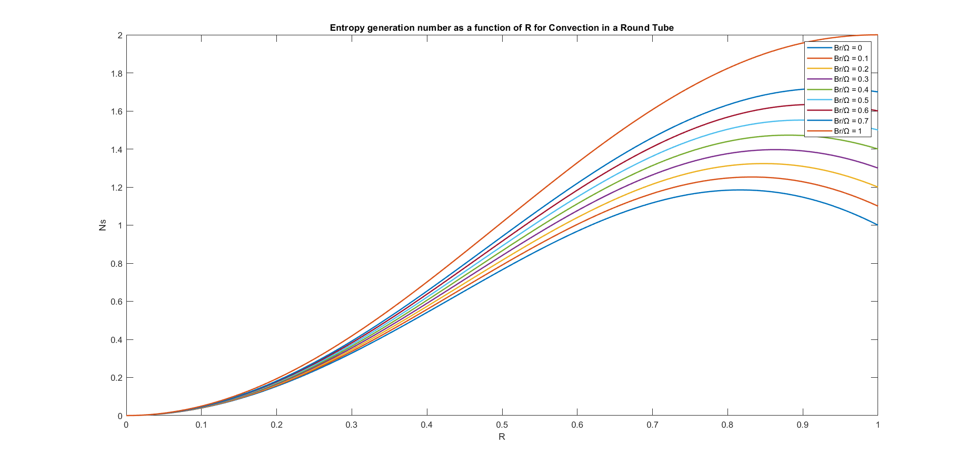
3.4
Convection in a circular annulus
Code :
R = linspace(0,1,100);
plot(R,(R.^3 - 2*R).^2 + 0*R.^2,LineWidth=1.5);
xlabel('R')
ylabel('Ns')
title(['Entropy generation number as a function of R for Convection in a Round Tube'])
hold on
plot(R,(R.^3 - 2*R).^2 + 0.1*R.^2,LineWidth=1.5);
plot(R,(R.^3 - 2*R).^2 + 0.2*R.^2,LineWidth=1.5);
plot(R,(R.^3 - 2*R).^2 + 0.3*R.^2,LineWidth=1.5);
plot(R,(R.^3 - 2*R).^2 + 0.4*R.^2,LineWidth=1.5);
plot(R,(R.^3 - 2*R).^2 + 0.5*R.^2,LineWidth=1.5);
plot(R,(R.^3 - 2*R).^2 + 0.6*R.^2,LineWidth=1.5);
plot(R,(R.^3 - 2*R).^2 + 0.7*R.^2,LineWidth=1.5);
plot(R,(R.^3 - 2*R).^2 + 01*R.^2,LineWidth=1.5);
hold off
legend("Br/Ω = 0","Br/Ω = 0.1","Br/Ω = 0.2","Br/Ω = 0.3","Br/Ω = 0.4","Br/Ω = 0.5","Br/Ω = 0.6","Br/Ω = 0.7","Br/Ω = 1")
Graph:

Slide 4
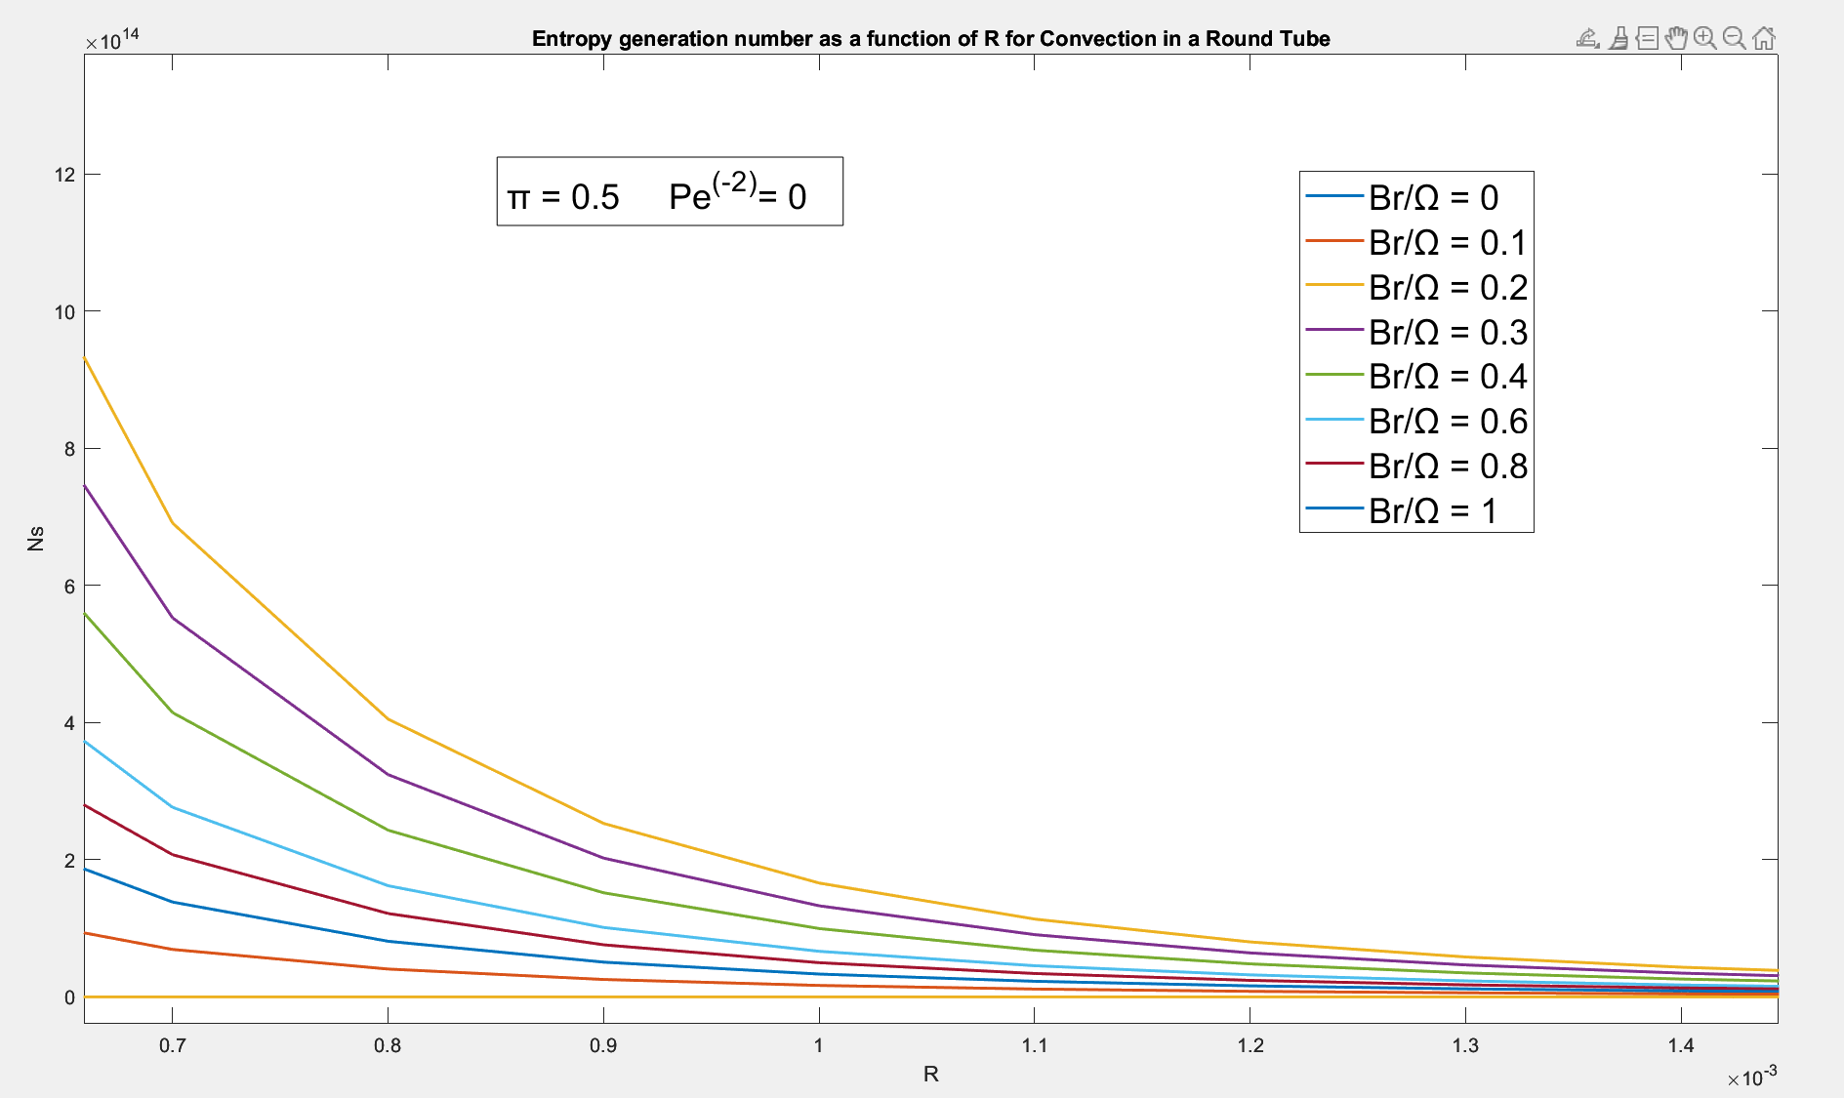
3.4
Convection in a circular annulus
Code :
c1 =0.167978719;
c2 = 1.08202128;
R = linspace(0,1,10000);
plot(R,(((2*R.*(1+(c2*log(R))-c2))/(c2-1) + (c2*R-R.^3)/(c2-1))).^2 + 4*1*((2*R-(c2./(R.^2))).^2)./(c1^2),LineWidth=1.5)
xlabel('R')
ylabel('Ns')
title(['Entropy generation number as a function of R for',' Convection in a Round Tube'])
hold on
plot(R,(((2*R.*(1+(c2*log(R))-c2))/(c2-1) + (c2*R-R.^3)/(c2-1))).^2 + 4*0.8*((2*R-(c2./(R.^2))).^2)./(c1^2),LineWidth=1.5)
plot(R,(((2*R.*(1+(c2*log(R))-c2))/(c2-1) + (c2*R-R.^3)/(c2-1))).^2 + 4*0.6*((2*R-(c2./(R.^2))).^2)./(c1^2),LineWidth=1.5)
plot(R,(((2*R.*(1+(c2*log(R))-c2))/(c2-1) + (c2*R-R.^3)/(c2-1))).^2 + 4*0.4*((2*R-(c2./(R.^2))).^2)./(c1^2),LineWidth=1.5)
plot(R,(((2*R.*(1+(c2*log(R))-c2))/(c2-1) + (c2*R-R.^3)/(c2-1))).^2 + 4*0.3*((2*R-(c2./(R.^2))).^2)./(c1^2),LineWidth=1.5)
plot(R,(((2*R.*(1+(c2*log(R))-c2))/(c2-1) + (c2*R-R.^3)/(c2-1))).^2 + 4*0.2*((2*R-(c2./(R.^2))).^2)./(c1^2),LineWidth=1.5)
plot(R,(((2*R.*(1+(c2*log(R))-c2))/(c2-1) + (c2*R-R.^3)/(c2-1))).^2 + 4*0.1*((2*R-(c2./(R.^2))).^2)./(c1^2),LineWidth=1.5)
plot(R,(((2*R.*(1+(c2*log(R))-c2))/(c2-1) + (c2*R-R.^3)/(c2-1))).^2 + 4*0*((2*R-(c2./(R.^2))).^2)./(c1^2),LineWidth=1.5)
hold off
legend("Br/Ω = 0","Br/Ω = 0.1","Br/Ω = 0.2","Br/Ω = 0.3","Br/Ω = 0.4","Br/Ω = 0.6","Br/Ω = 0.8","Br/Ω = 1")
Graph:

Slide 5
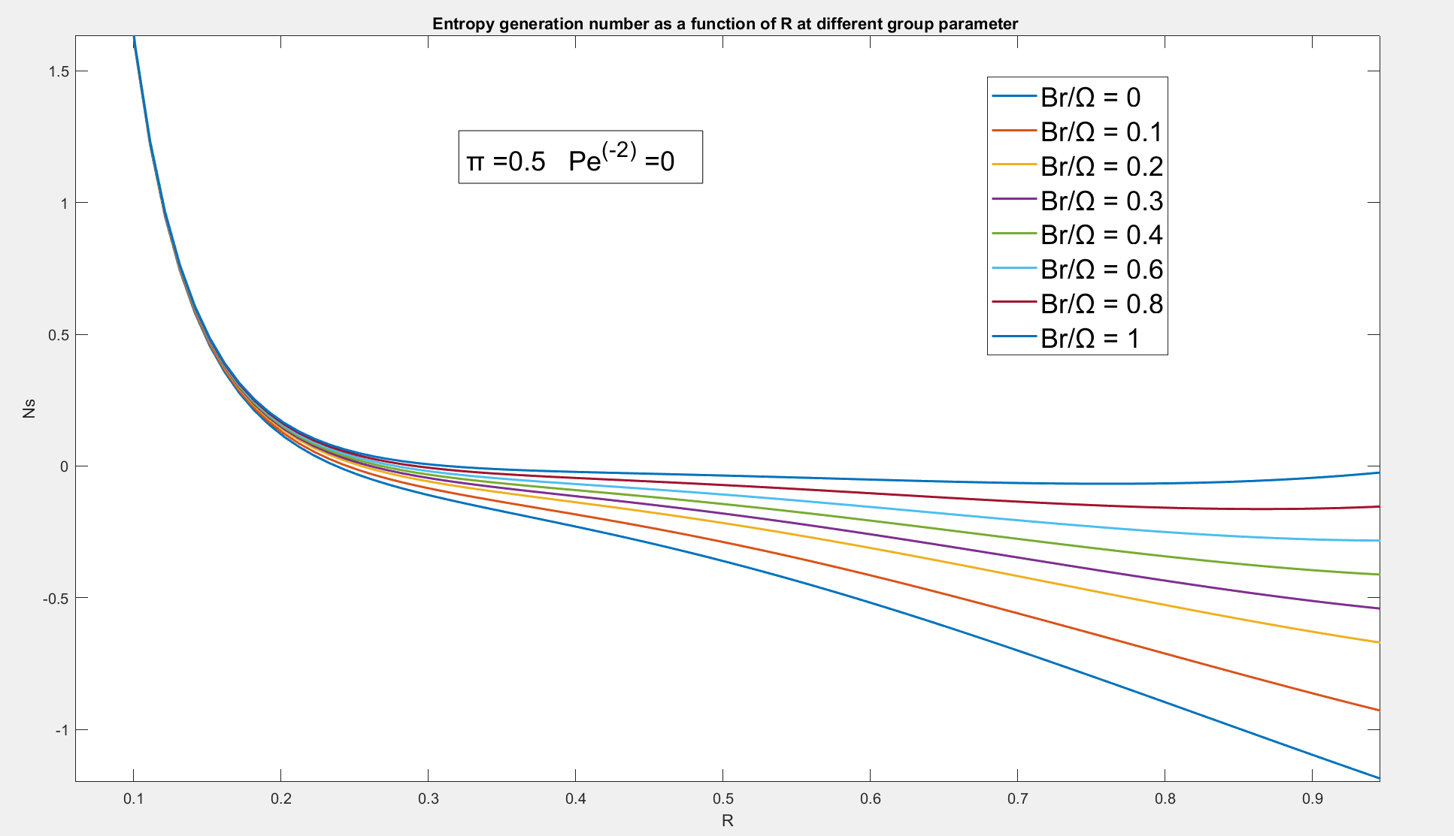
5
Code :
R = linspace(0,1,100);
plot(R,(0.25./R + R.*(2*log(R./0.5)-1)).^2./(0.25 - 2*log(0.5)+1)+ 0.5*1./((-0.3465736./R.^2)),LineWidth=1.5)
xlabel('R')
ylabel('Ns')
title('Entropy generation number as a function of R at different group parameter ')
hold on
plot(R,(0.25./R + R.*(2*log(R./0.5)-1)).^2./(0.25 - 2*log(0.5)+1)+ 0.5*0.8./((-0.3465736./R.^2)),LineWidth=1.5)
plot(R,(0.25./R + R.*(2*log(R./0.5)-1)).^2./(0.25 - 2*log(0.5)+1)+ 0.5*0.6./((-0.3465736./R.^2)),LineWidth=1.5)
plot(R,(0.25./R + R.*(2*log(R./0.5)-1)).^2./(0.25 - 2*log(0.5)+1)+ 0.5*0.5./((-0.3465736./R.^2)),LineWidth=1.5)
plot(R,(0.25./R + R.*(2*log(R./0.5)-1)).^2./(0.25 - 2*log(0.5)+1)+ 0.5*0.4./((-0.3465736./R.^2)),LineWidth=1.5)
plot(R,(0.25./R + R.*(2*log(R./0.5)-1)).^2./(0.25 - 2*log(0.5)+1)+ 0.5*0.3./((-0.3465736./R.^2)),LineWidth=1.5)
plot(R,(0.25./R + R.*(2*log(R./0.5)-1)).^2./(0.25 - 2*log(0.5)+1)+ 0.5*0.2./((-0.3465736./R.^2)),LineWidth=1.5)
plot(R,(0.25./R + R.*(2*log(R./0.5)-1)).^2./(0.25 - 2*log(0.5)+1)+ 0.5*0.1./((-0.3465736./R.^2)),LineWidth=1.5)
hold off
legend("Br/Ω = 0","Br/Ω = 0.1","Br/Ω = 0.2","Br/Ω = 0.3","Br/Ω = 0.4","Br/Ω = 0.6","Br/Ω = 0.8","Br/Ω = 1")
Graph:

Slide 6
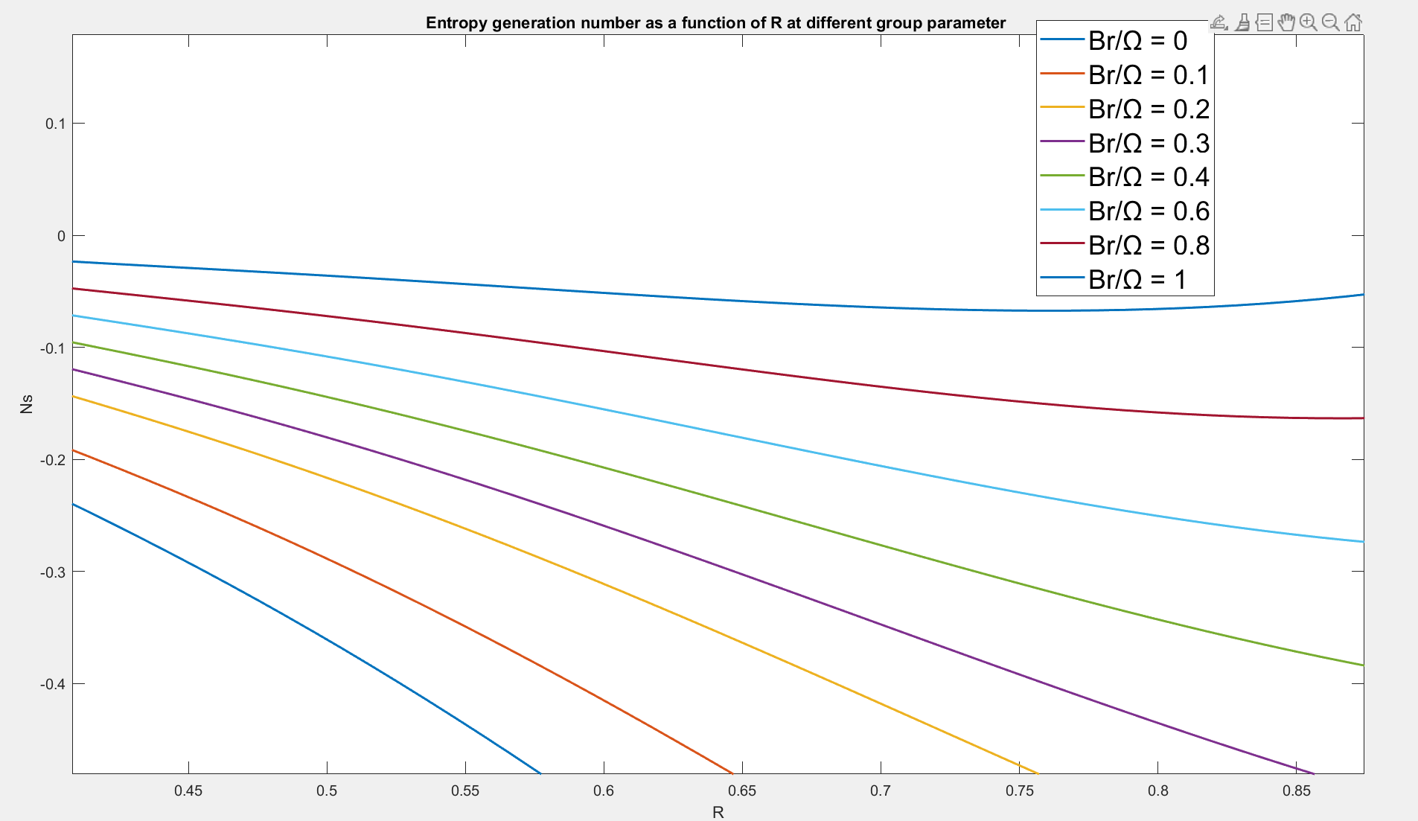
6
Code :
R = linspace(0,1,100);
plot(R,-0.4328085.*log(R)./(R.^3) -0.865617*(1-(0.25./R.^2)./R +1.4427./R+1*0.00000016.*R.^4),LineWidth=1.5)
xlabel('R')
ylabel('Ns')
title('Entropy generation number as a function of R at different group parameter ')
hold on
plot(R,-0.4328085.*log(R)./(R.^3) -0.865617*(1-(0.25./R.^2)./R +1.4427./R+0.8*0.00000016.*R.^4),LineWidth=1.5)
plot(R,-0.4328085.*log(R)./(R.^3) -0.865617*(1-(0.25./R.^2)./R +1.4427./R+0.6*0.00000016.*R.^4),LineWidth=1.5)
plot(R,-0.4328085.*log(R)./(R.^3) -0.865617*(1-(0.25./R.^2)./R +1.4427./R+0.5*0.00000016.*R.^4),LineWidth=1.5)
plot(R,-0.4328085.*log(R)./(R.^3) -0.865617*(1-(0.25./R.^2)./R +1.4427./R+0.4*0.00000016.*R.^4),LineWidth=1.5)
plot(R,-0.4328085.*log(R)./(R.^3) -0.865617*(1-(0.25./R.^2)./R +1.4427./R+0.2*0.00000016.*R.^4),LineWidth=1.5)
plot(R,-0.4328085.*log(R)./(R.^3) -0.865617*(1-(0.25./R.^2)./R +1.4427./R+0.1*0.00000016.*R.^4),LineWidth=1.5)
plot(R,-0.4328085.*log(R)./(R.^3) -0.865617*(1-(0.25./R.^2)./R +1.4427./R+0*0.00000016.*R.^4),LineWidth=1.5)
Graph:

